Slide 1




Project Avalanche
Team Booyah (Team 19)
Mario Aguilar Margaret Baxter
Patrick Quach Christine Russell

Slide 2
Introduction
Big Winner (Codename: Project Avalanche)
Football season simulator
User is given current team data
User competes against a Predictor Algorithm
Predictor Algorithm uses a combination of statistic algorithms
Utilize Agile techniques (SCRUM Development)

Slide 3

Technical aspects
Big Winner:
Runs on an Android device
Predictor Algorithm is a combination of statistic algorithms:
Power Ranking
Bayesian Analysis
Pi Rating System
Predictions are acquired through Service Provider Interface
Uses SQLite as its Database Management System (DBMS)
Exploits mobile handheld device technology for its User Interface
Sounds
Graphics

Slide 4
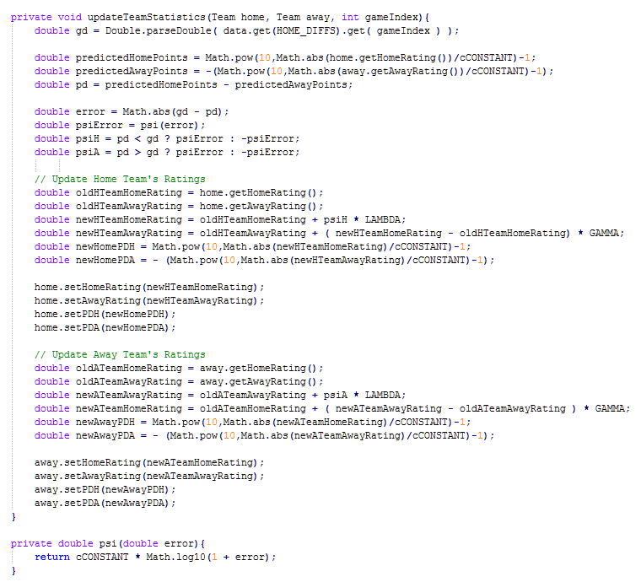
Code Snippet

Slide 5
Video Capture

Slide 6
Conclusion
Predictor Accuracy: 78.13% - 83.98%
Lessons Learned:
Developing an Android Application
User Interface considerations
Working with a GUI Layout
Graphics editing
Sound integration
Model-View-Presenter Design
Statistic algorithm optimization
SQLite
XML

